Slide 1
Relaxation: There’s an App for That!
Tim Ringgold, MT-BC
WRAMTA Conference 2018
Ontario, CA

Slide 2
386___ Umbrella Code 1 of 2
Tim Ringgold, MT-BC
WRAMTA Conference 2018
Ontario, CA

Slide 3
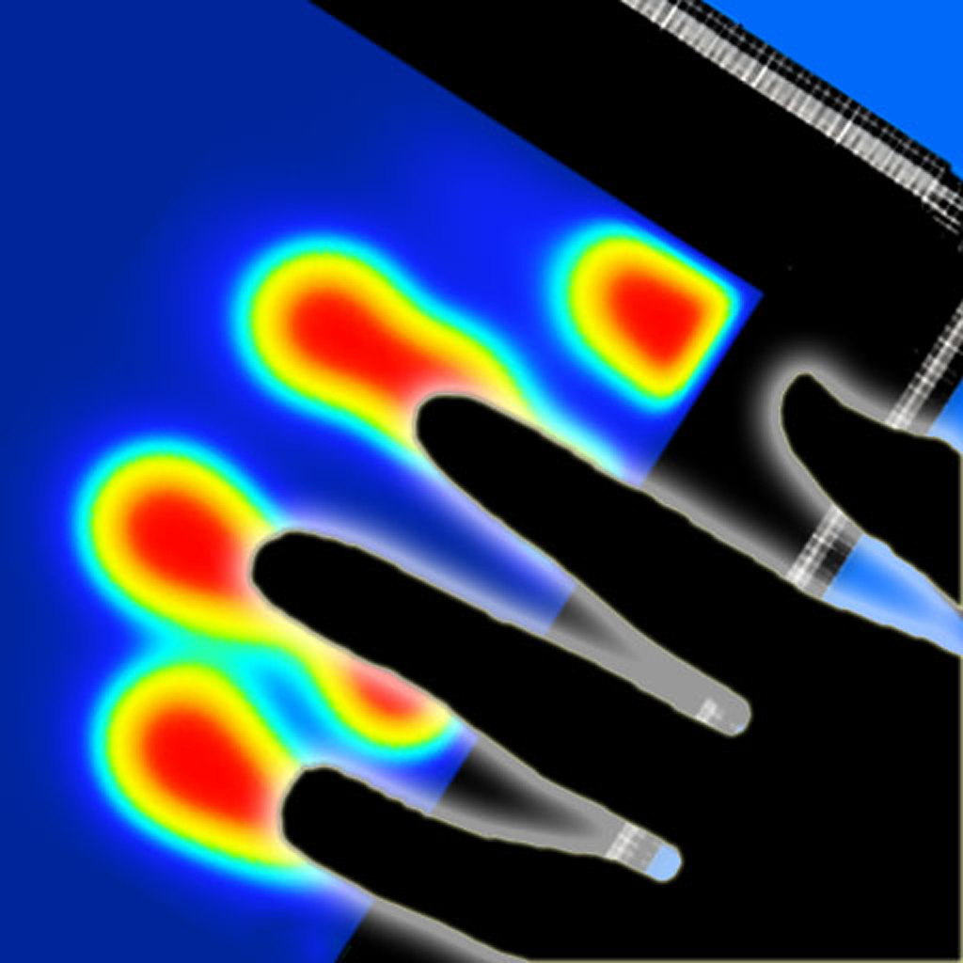
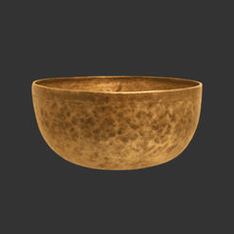
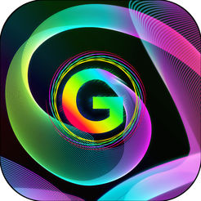
Relaxation Apps
Magic Zither
Zen Sands
Headspace
Calm
Relax Melodies
Heat Pad
Simply Being
Insight Timer
Bowls HD
Gravitarium

Slide 4
Magic Zither
iPad, iPhone, Android
Beautiful sound samples and visual interface
Learn traditional Chinese songs
Write, record, jam with existing songs
FREE with in app purchases

Slide 5
Headspace
iPad, iPhone, Android
GIANT Guided meditation library
Super easy / approachable / fun even!
Guided meditations for many occasions
$12.99/mo or $94.99/yr (=$7.92/mo.)

Slide 6
Relax Melodies
iPad, iPhone, Android
GIANT relaxing sound & meditation library
Use preset combinations or make your own!
Guided meditations for many occasions
FREE (You can buy additional sounds in the app)

Slide 7
Simply Being
iPad, iPhone, Android
Guided meditations and relaxing sounds
Select amount of time you have
Mix volume of voice and background
$1.99 to purchase

Slide 8
Bowls HD
iPad only
Selection of bells, gongs, and singing bowls
BEAUTIFUL layout & quality audio samples
Two ways to ‘play’ the bowls & record, too!
$1.99 to purchase

Slide 9
Zen Sands
iPad, iPhone, Android
Relaxing, but captivating
Beautiful sound samples and visual interface
Great Zen quotes between levels
FREE with in app purchases (add’l levels)

Slide 10
Calm
iPad, iPhone, Android
Guided Meditation and relaxing music library
Bedtime stories!
GORGEOUS visual scenes with nature sounds
$59.99/yr after free 7 day trial

Slide 11
Heat Pad
iPad, iPhone
Heat responsive fingerprints
Tons of different settings
Relaxing music
FREE (buy the upgrade for no ads on screen)

Slide 12
Insight Timer
iPad, iPhone, Android
“Largest Selection of Free Guided Meditation”
Social component
Huge library of music by time and genre
FREE

Slide 13
Gravitarium
iPad, iPhone
This app will melt your face off
You will conjure space unicorns
Time as you know it will disappear
FREE (with in app purchases)

Slide 14
Your Turn! What’s YOUR favorite app? C’mon up and share!

Slide 15
___zxh Umbrella Code 2 of 2
Tim Ringgold, MT-BC
WRAMTA Conference 2018
Ontario, CA

